Slide 1
Convolutional Layers - Spectral methods
2025. 01. 14
종석뢰
zongshilei001@gmail.com

Slide 2
Outline
The concept of convolution
Fourier transform
Convolution on graphs
Chebyshev approximation
Conclusion

Slide 3
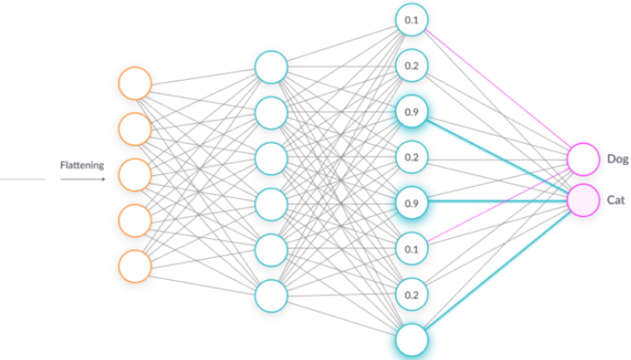
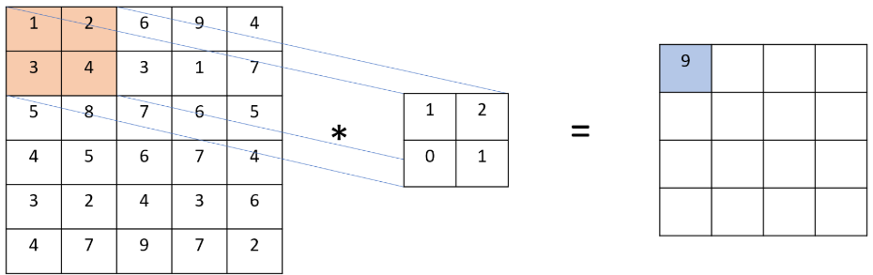
Convolutional Neural Network

Slide 4
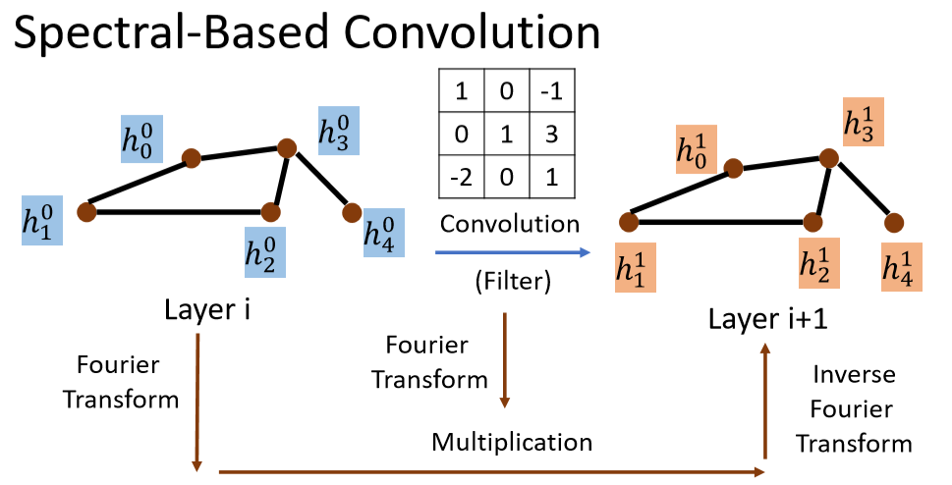
Spectral methods
Use frequency domain to understand the operation of convolutional layer

Slide 5
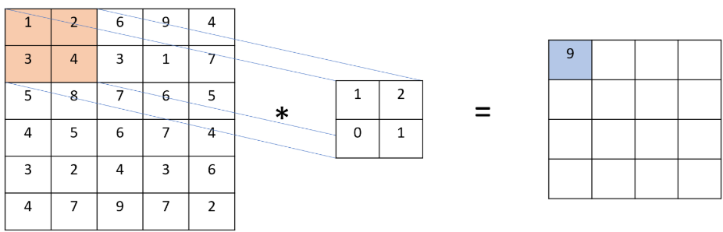
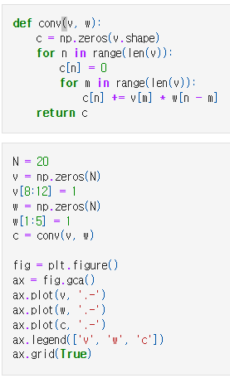

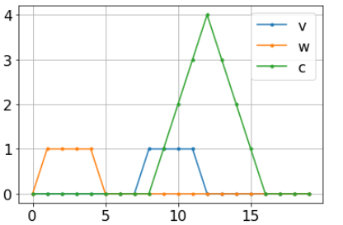




Convolution
$$v$$
$$w$$
$$c$$
$$Visualization of vectors on the axes$$
$$Time domain$$

Slide 6
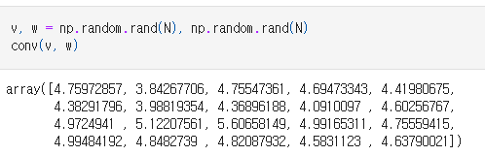
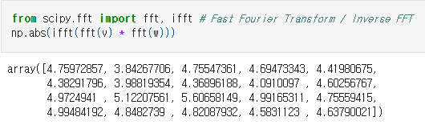
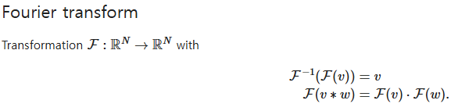



Fourier transform
Fourier transform method can speed up the calculation of convolutional neural network
$$Time Complexity:O(N^{2})$$
$$Time Complexity:O(NlogN)$$
$$Inverse Fourier Transform$$

Slide 7
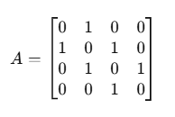

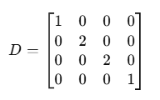

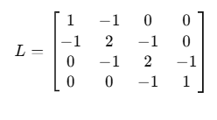

Convolution on graphs
Graph Laplacian
Adjacency matrix:
4
Degree matrix：
1
3
2
Laplacian ：
Normalized laplacian：

Slide 8
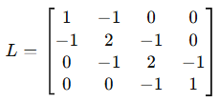
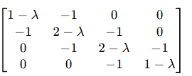

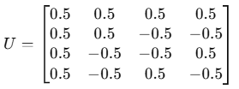




Convolution on graphs
Graph spectrum, Fourier transform, and convolution
Spectral decomposition of the Laplacian:
$$U:Eigenvectors$$
$$Λ:Eigenvalues$$
Fourier transform: if v is a vector of features on the graph, then:
$$\det\left(L−ΛI\right)=$$
Convolution with a filter U $∙W$
$$\det\left(L−ΛI\right)=Λ\left(Λ−1\right)\left(Λ−2\right)\left(Λ−3\right)$$
$$Λ_{1}=0,Λ_{2}=1,Λ_{3}=2,Λ_{4}=3$$

Slide 9
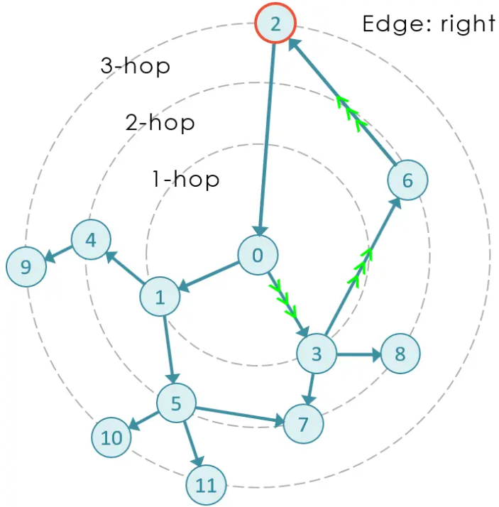



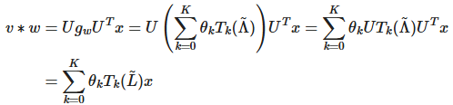
Chebyshev approximation
The Fourier transform relies on the global features (eigenvectors) of the graph. For dynamic graphs or large graphs, it is very expensive to calculate the eigendecomposition.
Frequency domain convolution lacks direct locality, while graph signals often need to preserve local structures.
Chebyshev approximation
Chebyshev approximation of the filter

Slide 10
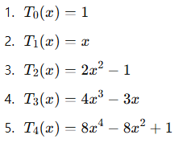
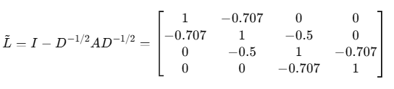
Chebyshev approximation

Slide 11

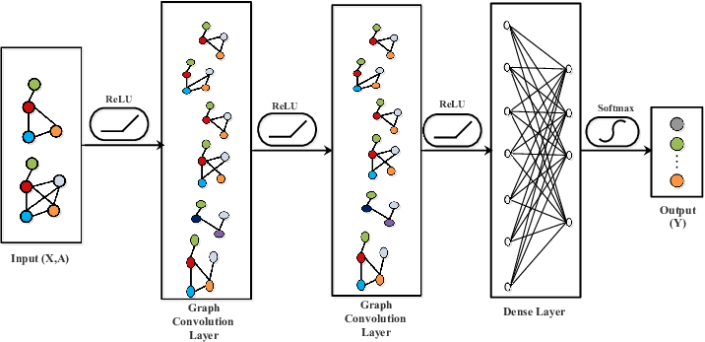



GCN
$$First-order approximation of GCN, k=1$$
$\text{Chebyshev}\text{,}$ k=2

Slide 12
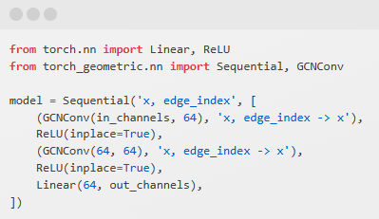
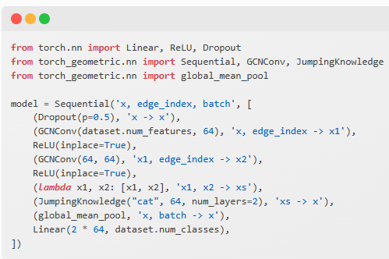
PyTorch Geometric
Although the implementation in PyTorch Geometric is in the time domain, it implicitly has theoretical support in the frequency domain:
Frequency domain : interpret convolution as the manipulation of signal frequency.
Time domain implementation: directly operate on the adjacency matrix to avoid calculating eigendecomposition and improve efficiency.

Slide 13
Conclusion
Understand the convolutional layer from the perspective of frequency domain.
Fourier transform is used to convert the time domain of the graph into the frequency domain to accelerate the calculation of the graph Convolution.

Slide 14
Q&A

